Slide 1
Lecture 4
CS404: Software Engineering
Software Life Cycle
Software Engineering: A Practitioner’s Approach, 7/e
by Roger S. Pressman
Slides copyright © 1996, 2001, 2005, 2009 by Roger S. Pressman
Software Engineering 9/e
By Ian Sommerville

Slide 2
Software Development Life Cycle (SDLC)
The Software Development Life Cycle (SDLC) refers to a methodology with clearly defined processes for creating high-quality software.

Slide 3
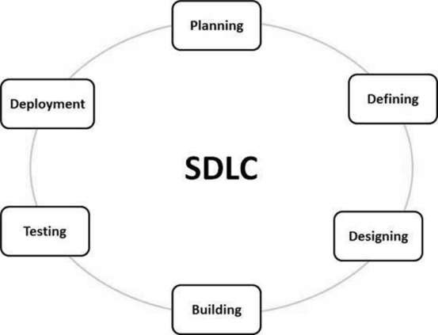
Phases of SDLC
Requirement analysis
Planning
Software design
Software development
Testing
Deployment

Slide 4
SDLC Model/Software Process Models
Linear Sequential Model/Waterfall Model
V-Model
Spiral Model
Iterative Model

Slide 5
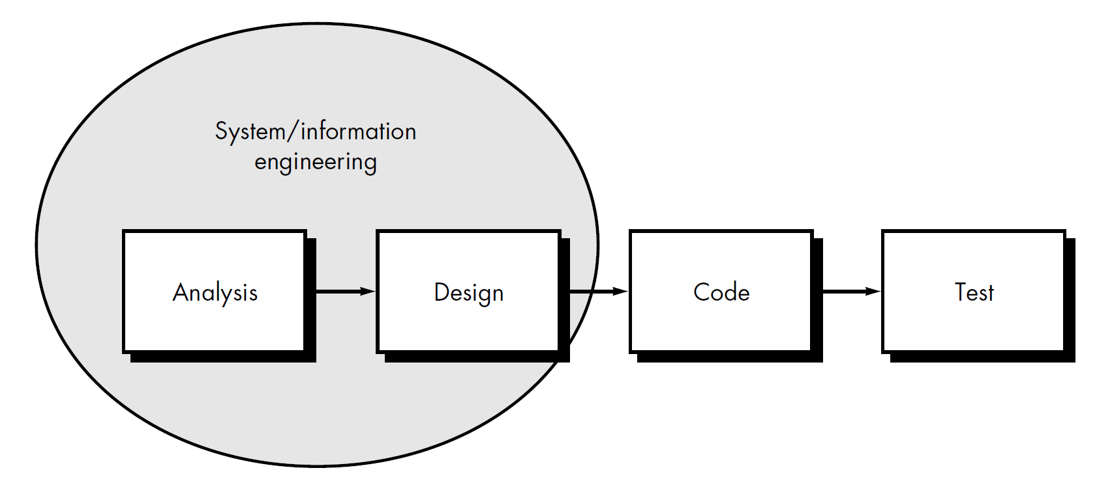
Linear Sequential Model/Waterfall Model
Support
Reapplies each the preceding phases to the existing program

Slide 6
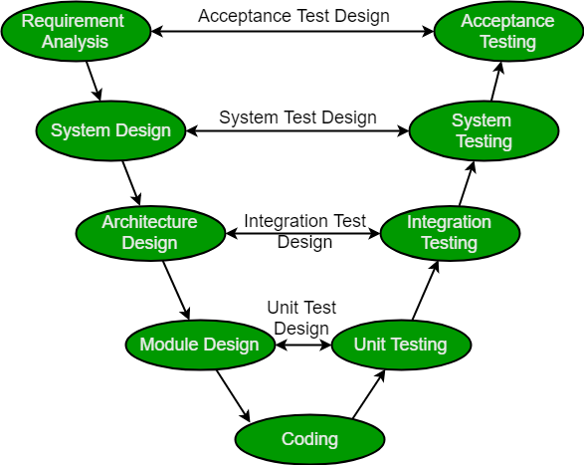
V-Model
Also known as verification and validation model
Verification is static analysis
Validation is dynamic analysis

Slide 7
End of lecture 4

